Slide 1
SPRING MVC FEATURES

Slide 2
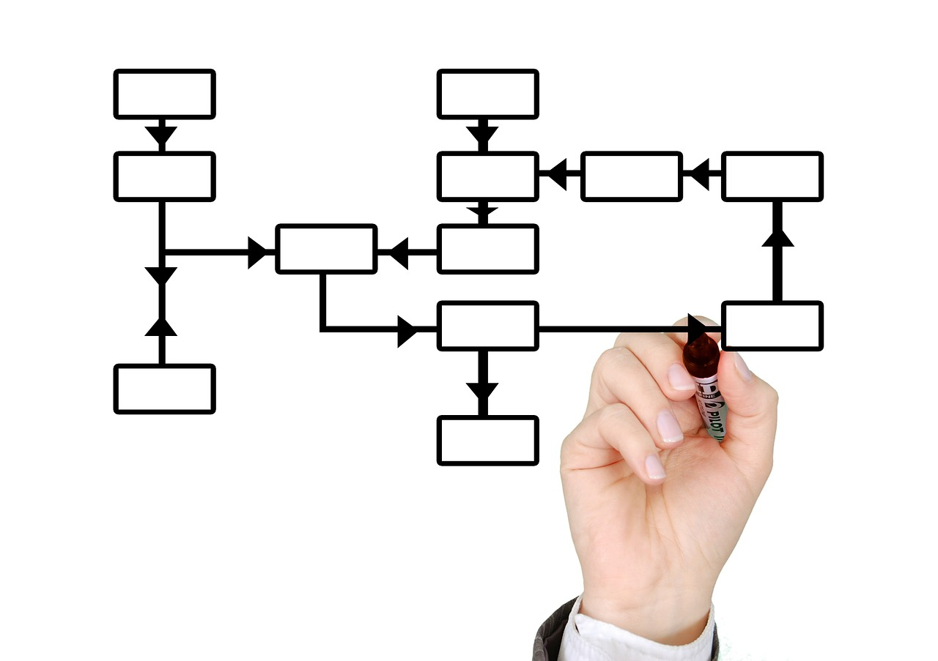
SPRING MVC
Web framework that establishes a model-view-controller architecture for applications.
Built on top of the Spring IOC container
Integrates with other Spring projects

Slide 3
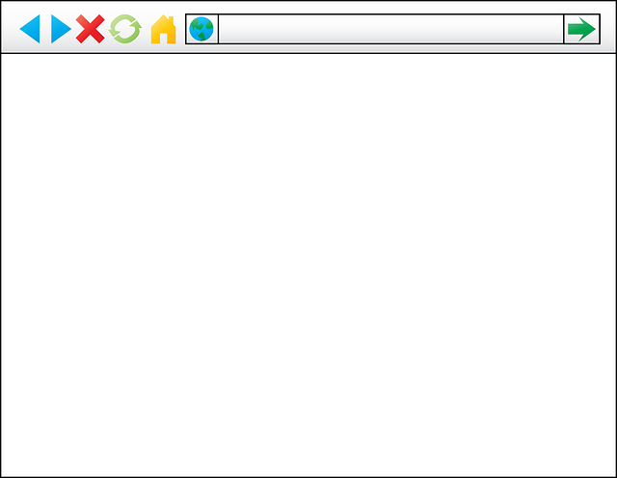
Request Processing LIFECYCLE
Controller
Request
Front Controller
Model
Response
Model
View
Servlet Container

Slide 4
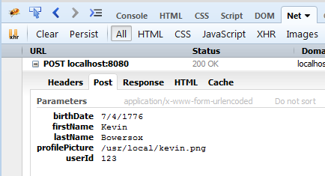
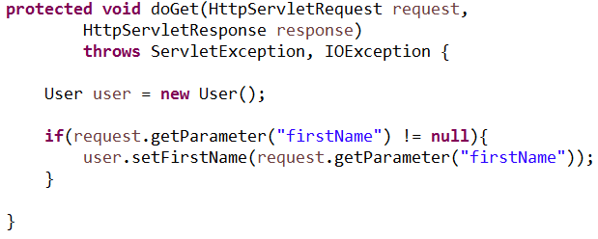
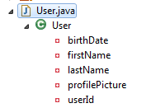
DATABINDING

Slide 5
Other Features
Error handling & validation
File upload support
Spring tag library
View resolution

